Slide 1
Blockchain: A technology for managing organizations in the unexpected?
Pr. Cécile Godé
March 9, 2021
Dialog # 3
Block Chain and Disaster Risk Reduction

Slide 2
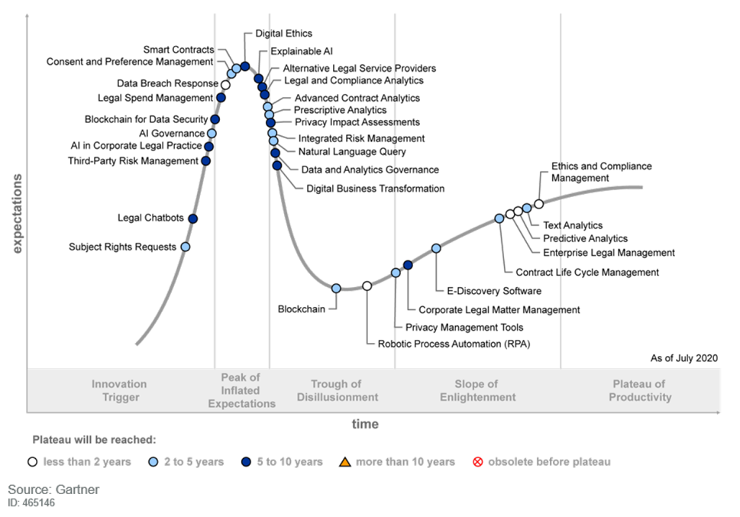
The COVID-19 pandemic: An unexpected situation
How can blockchain support organizations when they face with a black swan event?
The covid-19 can be referred to a Black Swan event (Taleb, 2007)
An unexpected situation
Surprising, hard-to-predict, with potentially high impacts on organizations
Their causalities are often explained after their occurrence
Taleb N.N. (2007), The Black Swan. The impact of the highly improbable, Penguin Books, London.

Slide 3
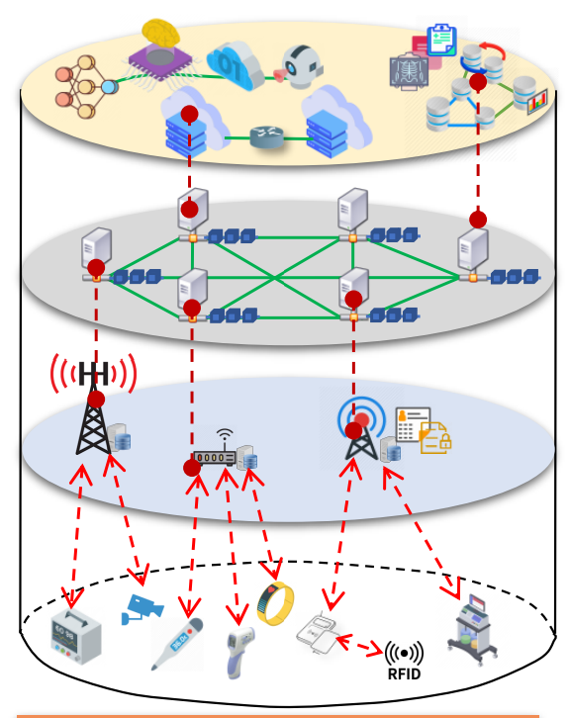
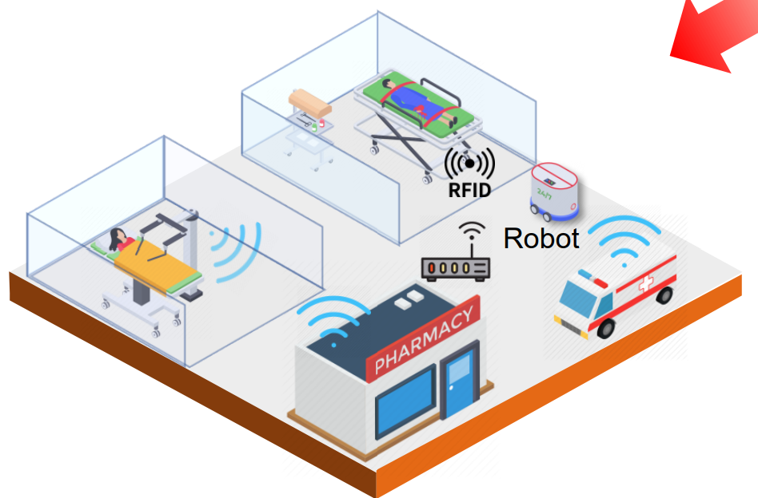
Blockchain to lessen the effect of the pandemic
A trustworthy contact tracing system
A purely decentralized system without a trusted third party
To track and trace test-kits, infected or vaccinated individuals, etc.
No more questions about personal data that could be misuse by governments for instance
A smart hospital based on blockchain-enabled IoMT (Internet of Medical Things)
Immutability and traceability of stored data and smart contracts
Real-time monitoring of beds availability, malfunctions of medical devices, environmental hygiene and air quality, sterilization of medical devices, cleaning robots, etc.

Slide 4
Blockchain to foster digital resilience
Digital resilience is the ability of organizations and teams to build a robust digital environment to prevent, anticipate, absorb and adapt to unexpected events
Many companies have suffered serious supply chain disruptions
Blockchain allows for real-time location information and for the complete history of a product from start to finish
From every time a product is adjusted as well as the documentation of the transaction, this creates full transparency and knowledge
Digital resilience in supply chain => Investments in reducing technical and operational shortcomings and testing in new blockchain applications

Slide 5
Handling change management: A key challenge
Blockchain has the potential to transform and reconfigure business processes and work practices in organization (Orlikowski and Scott, 2016; Schildt, 2017)
As an emerging technology, practical applications of blockchain are largely unrealized
It may have a dramatic impact on working, organizing and on broader aspects of organizational system (Li et al., 2018), e.g.:
Escaping the “centralized world” of hierarchical organizations towards more agile and flatter organizations => re-allocation of roles and power
Automating tasks that were previously handled by employees thanks to blockchain-based smart contracts => perceived threat

Slide 6
Thank you for your attention

