Slide 1
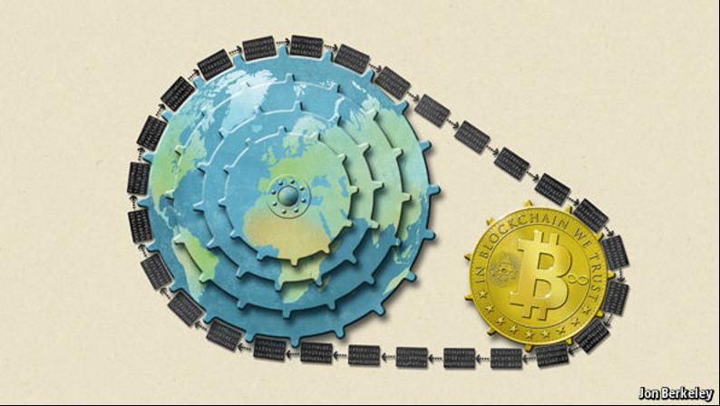
CSPRI Blockchain–DRR Research What is blockchain and why it matters for DRR
March 9, 2021
Neil H. Wasserman nhwasserman@gwu.edu Tel. 202-556-1501

Slide 2
Blockchain structure - Linked list
Replication of linked data blocks and operational rules
Hash-based Data Stability
Validation by incentivized consensus
Closure (e.g., for transaction sets)
NIST Blockchain Technology Overview Draft NISTR 8202

Slide 3
Bitcoin versus Blockchain
Bitcoin
Blockchain
Currency
Physical and virtual objects
Transactions
Business logic - Smart contracts
Ownership
Conditional relationships
Diadic transfer
Multi-party and social
Single instance / closure
Transaction chain

Slide 4
Blockchain capabilities
Technical
Business
Pervasive rule-based contracts and verification
No central administrator to assure trust
Identity /trust
Trust
Non-repudiation
There is no “god”
There are many angels
Provenance
Distributed ledger
Ownership – Virtual objects
No one owns the transaction record
Multiple sources of validation
Payments
Data
Services
Treatment regimens
Consensus algorithms
Proof of Work, Proof of Stake
Only one valid chain
Resolution of competing chains
Transferability
Rule-based transactions (Smart Contracts)
Smart contracts
Complex conditions for transactions
Not in original blockchain, Ethereum
Anonymization
Blockchain as a Service
Availability / confidentiality

Slide 5
Blockchain for DRR processes Addressing 1) Risk, 2) Governance, 3) Resilience, 4) Preparedness
Shorter
Response
Time
Incidents
Fire
Flood
Famine
Earthquake
Pandemic
Timescale
Preparedness
Recovery
Prevention / Mitigation
Prevention / Mitigation
Longer
Blockchain Applications
DRR Impact
Asset registration
Personal / entity identity
Data access, permissioning, validation
Transaction records and conditions (supply chain)
Contracts management
Funds and outcomes tracking
Health data infrastructure – disease and vaccination tracking
Predictive modeling – disaster risk mapping
Carbon accounting and trading
Infrastructure certification
Resource allocation, distribution, and balancing
Monitoring – GPS and IoT data integration and security

